Slide 1
Object detection accelerator in Xilinx PYNQ-z2
Team 10
林哲嶔 劉子傑 黃紹軒

Slide 2
Github
https://github.com/tzuj6/Object-detection-accelerator-in-Xilinx-PYNQ-z2?fbclid=IwAR1K5Dv2I6LTZSAOeqgcRY5QYhJOHk7xceTGMe77Wn6VJTiJxKMmxathotA

Slide 3
Outline
Algorithm Introduction
Hardware Architecture
HLS Optimization
PYZQ Board

Slide 4
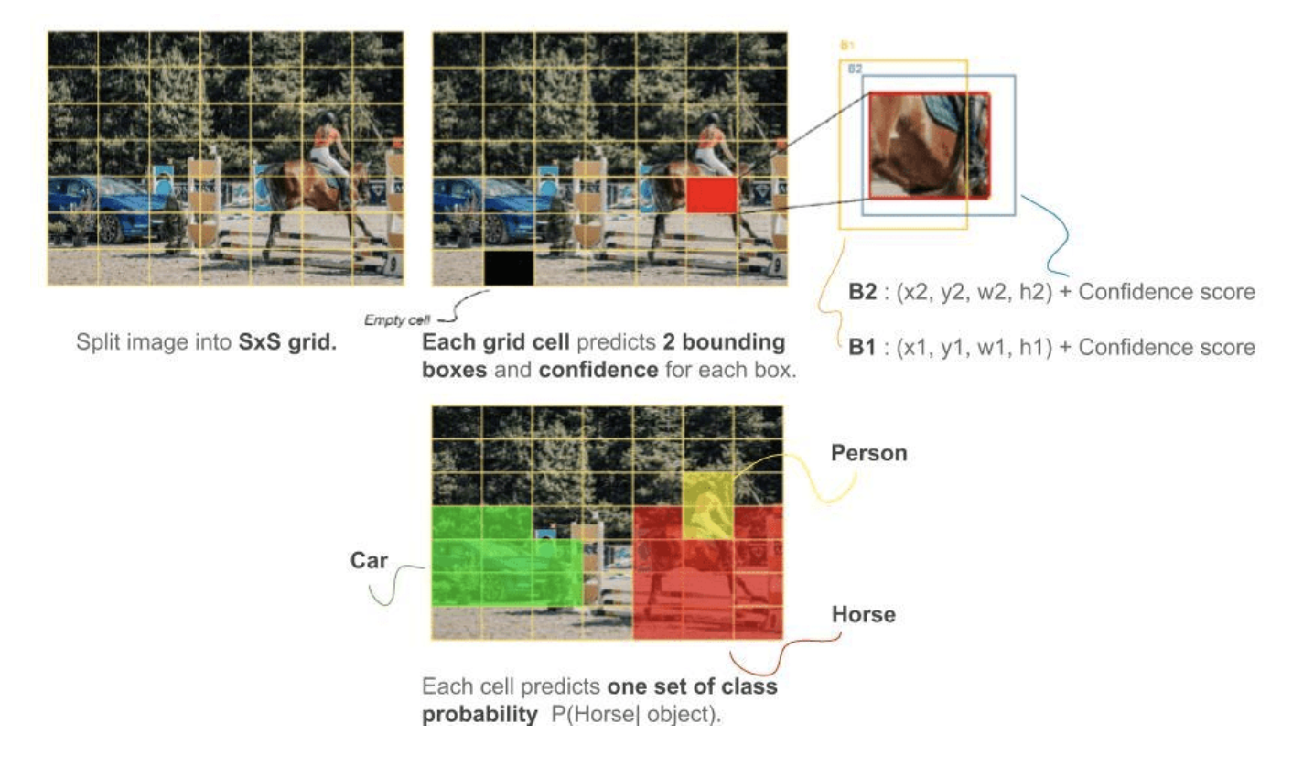
YOLO
Detects bounding box coordinates and class probabilities directly from the image
The predicted tensor is of S×S×(B×5+C) dimension, the paper divides the input image into a 7x7 grid and predicts B=2 boxes per cell
Notes:
YOLO將原本分散的object detection 步驟融合成一個single neural network，透過整張影像的features來預測每一個bounding box，並且同時計算每個bounding box對於每一個class的機率
每個影像切成SxS的格子(grid)，如果格子中間有物體則該格子會負責去偵測該物體。每個格子又會預測B個bounding boxes與其confidence scores，
影像切成SxS個grid cell，每個grid cell預測B個b-box與C class的機率

Slide 5
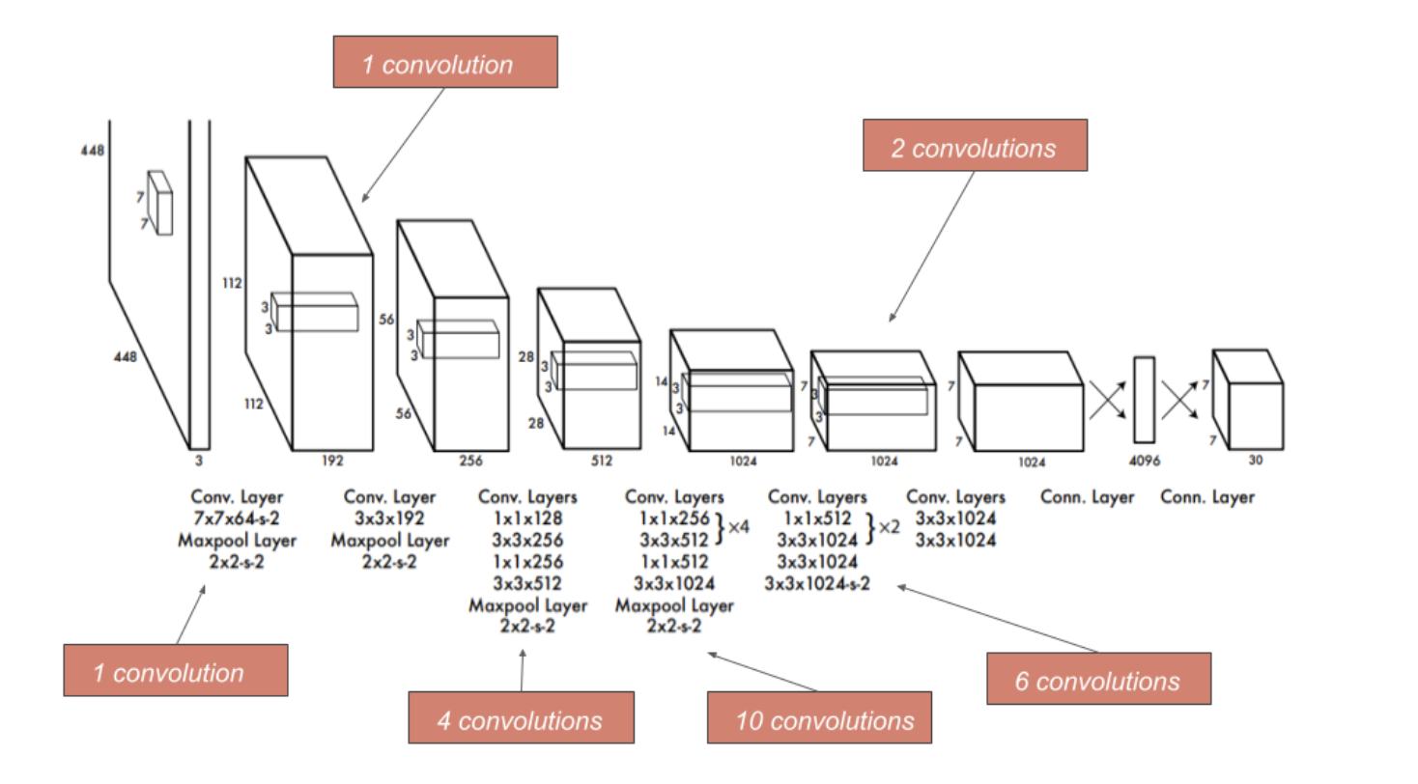
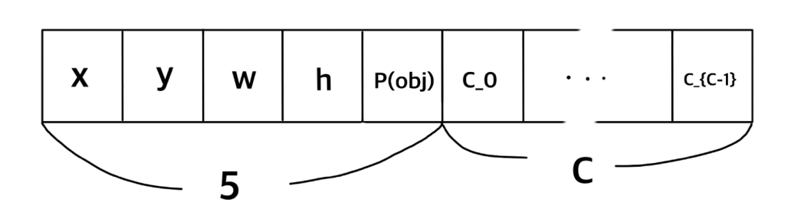
YOLO – Network Architecture
channels

Slide 6
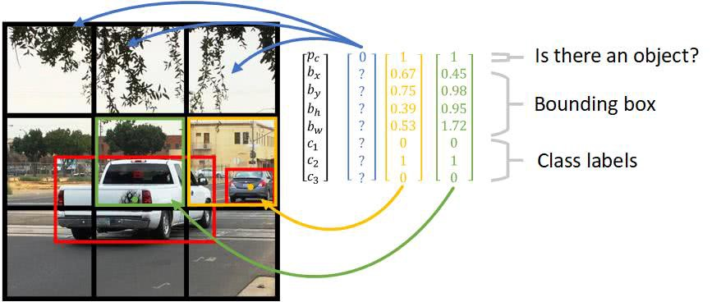
YOLO - Prediction

Slide 7
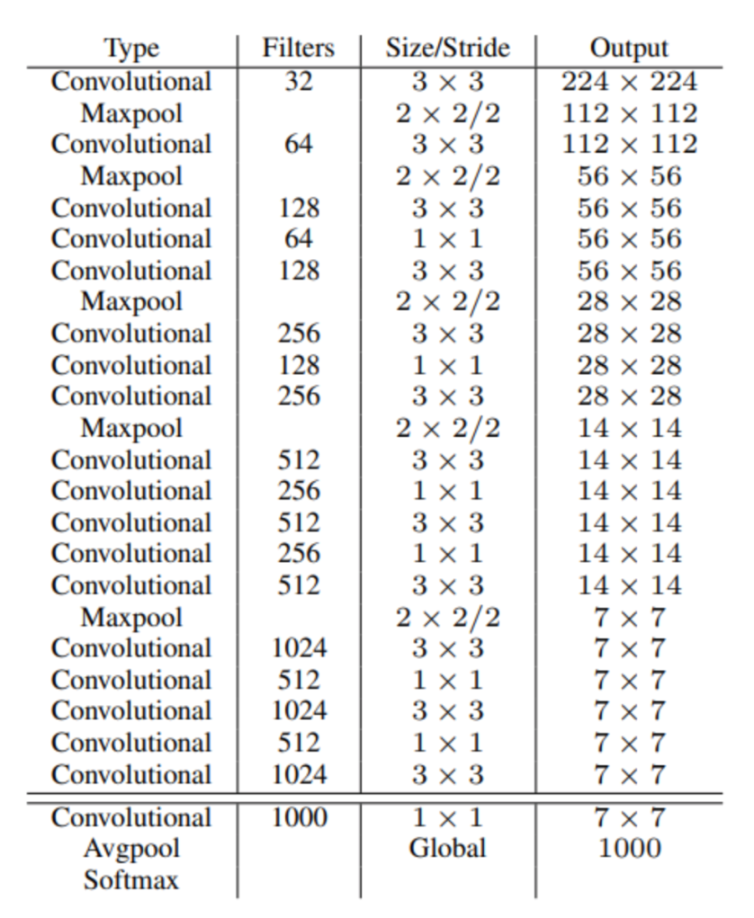
YOLOv2
Adjustments for a better YOLO
Batch normalization
Fine-Grained Features
Multi-Scale Training
Lighter/faster model: GoogeLeNet -> Darknet-19
Notes:
Model 多了幾層conv sofmax的部分是用軟體實現 conv 與 maxpool硬體
多了3曾conv, max pool, 2層conv 把ave拿掉

Slide 8
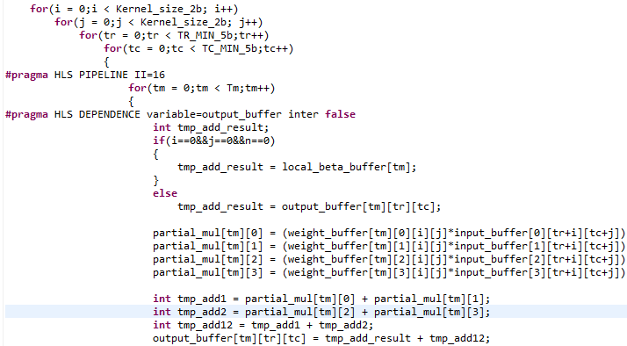
Conv implementation
4
4
4
Notes:
Tr = row
Tc = col

Slide 9
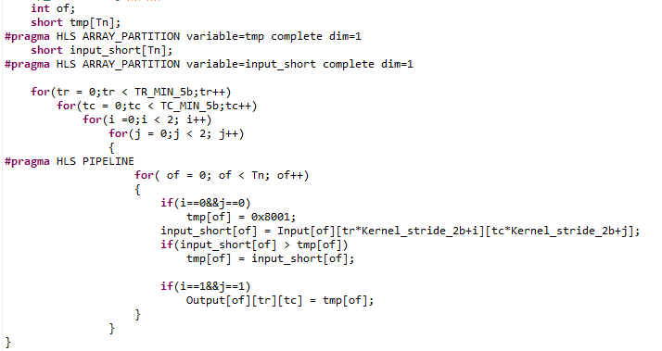
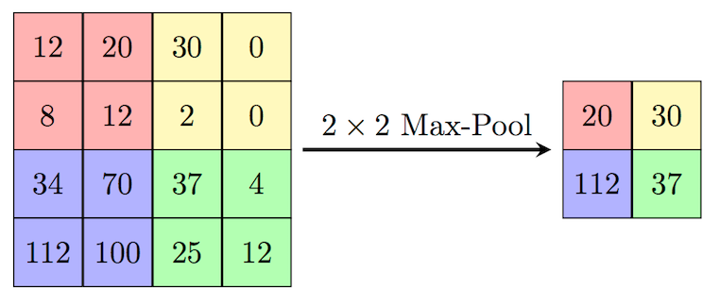
Maxpool implementation
Notes:
Of input c
2x2maxpool

Slide 10
System
Pre-processing: RGB normalize to [0,1], image resize implement with CPU
YOLOv2: model inference implement with FPGA
Post-processing: bounding box implement with CPU

Slide 11
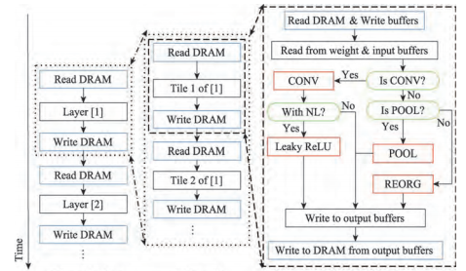
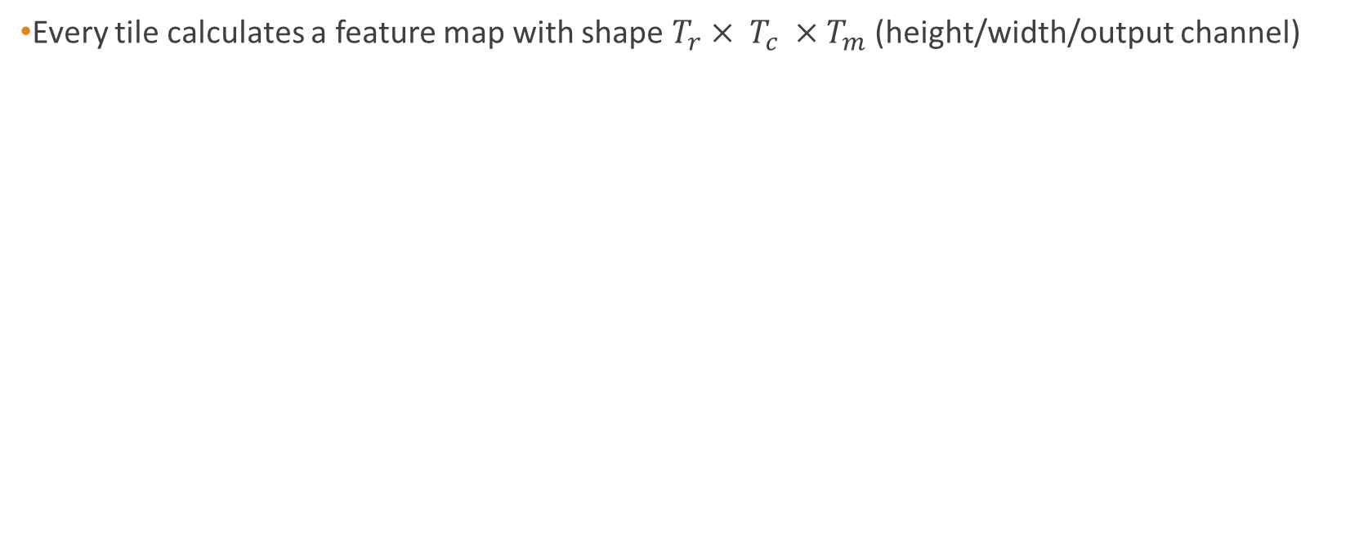
Hardware Architecture
Every tile calculates a feature map with shape $T_{r}× T_{c} ×T_{m}$ (height/width/output channel)

Slide 12
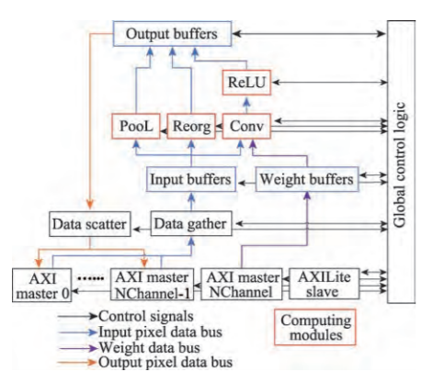
Accelerator Modules
Implement Yolo Algorithm
Temp data storage
Control Read/Write

Slide 13
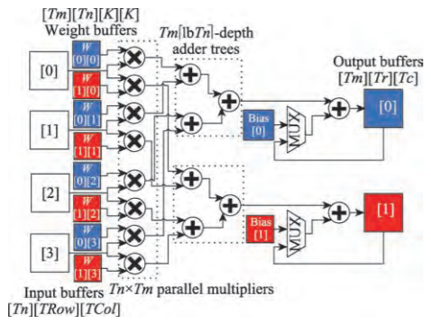
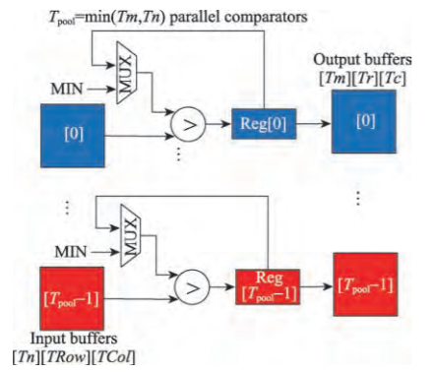
Sub modules Architecture
Convolution Module
Pooling Module

Slide 14
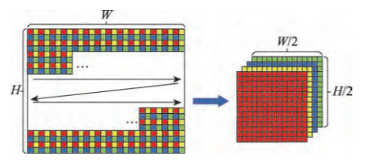
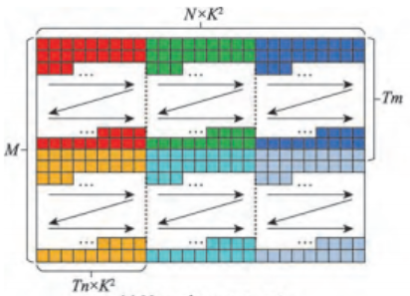
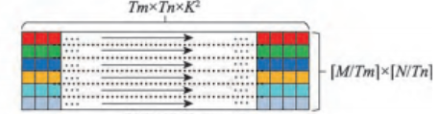
Data Reorganization
Optimize reading sequence in
DRAM for better operation time.

Slide 15
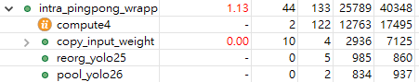
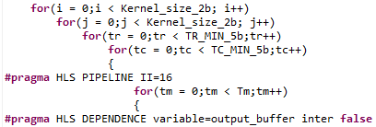
Optimization
Pipeline on Tc loop => unroll on Tm loop (different output channel can do in parallel)
Pipeline II =>16 (fix the timing violation)

Slide 16
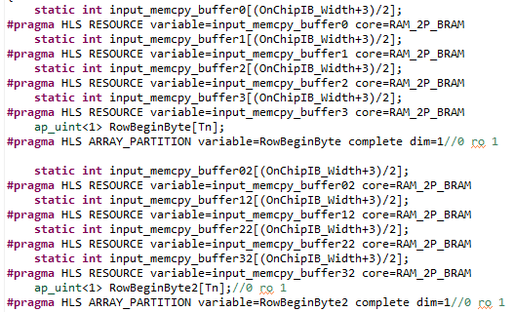
Optimization
Hardware resource
Int-16 quantization

Slide 17
Double buffer
Load input/weight from DRAM
Load input/weight from DRAM
Load input/weight from DRAM
Load input/weight from DRAM
Load input/weight from DRAM
Compute
Compute
Compute
Compute

Slide 18
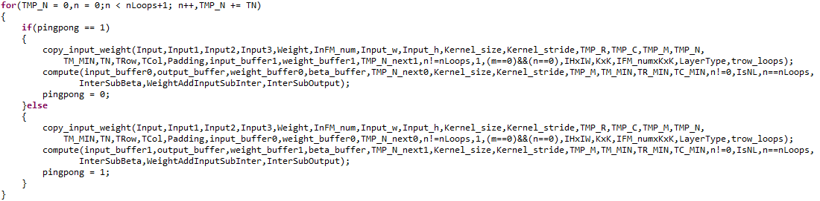
Double buffer

Slide 19
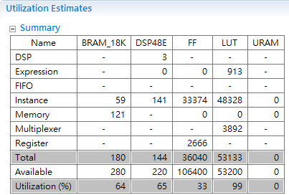
Result
Tn=4, Tm=30, Tc=Tr=26

Slide 20
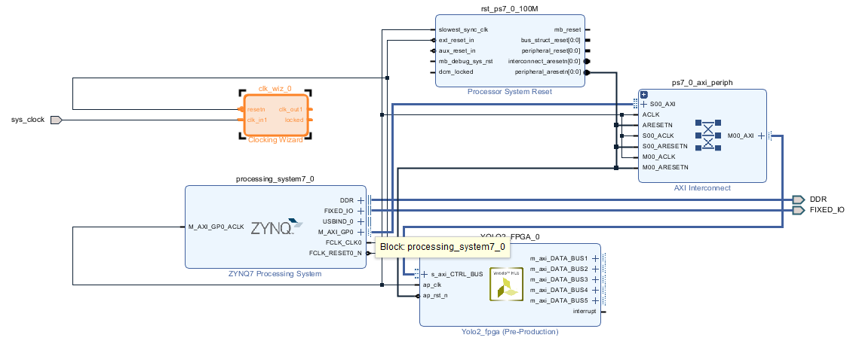
System block diagram

Slide 21
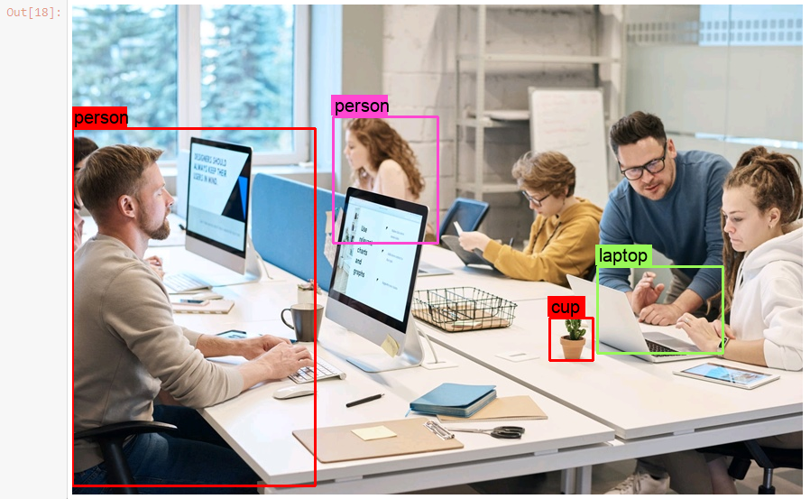
PYNQ
Image preprocess: 0.23s
Load image to mem time: 0.022s
FPGA process time: 1.09s
Post process time: 0.558s

Slide 22
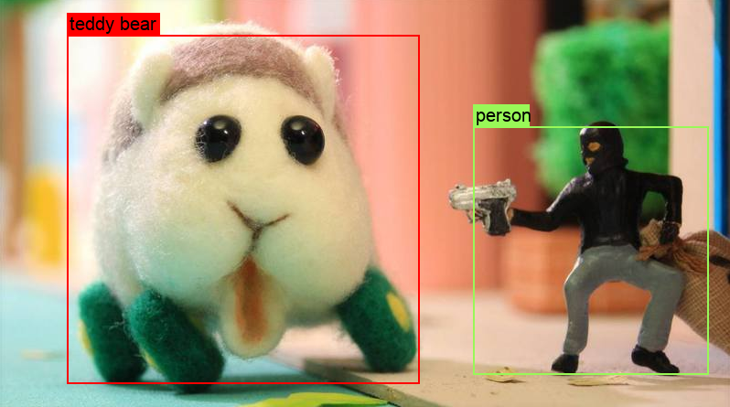
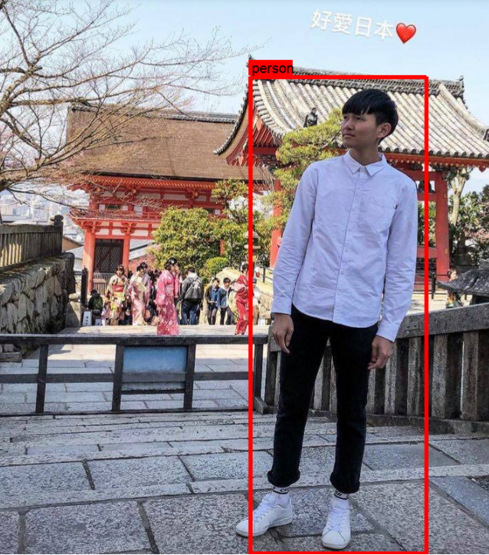

Slide 23
Reference
陈辰, 柴志雷, 夏珺. 基于 Zynq7000 FPGA 异构平台的 YOLOv2 加速器设计与实现. 计算机科学与探索,2019, 13(10): 1677-1693
Github: https://github.com/dhm2013724/yolov2_xilinx_fpga

